Slide 1
PRESERVING PRIVACY FOR PUBLISHING-TIME-SERIES DATA WITH DIFFERENTIAL PRIVACY
Master Thesis Proposal Defense – 28 Jun 2022
Student: Lai Trung Minh Duc – 2070686
Instructor: Assoc. Prof. DANG TRAN KHANH

Slide 2
Greetings the Board of Judges
Assoc. Prof. NGUYEN THANH BINH
Assoc. Prof. TRAN MINH QUANG
Dr. PHAN TRONG NHAN

Slide 3
Contents
Urgency of this study
Social context
Academic context
Corporate context
Literature review:
Differential Privacy
Some Differential Privacy techniques
About the thesis:
Data information
Data features evaluation + Data metrics settings
Research outcome expectation
Expected timeline
Q/A
Reference

Slide 4
Urgency of this study
Social – Academic – Corporate

Slide 5
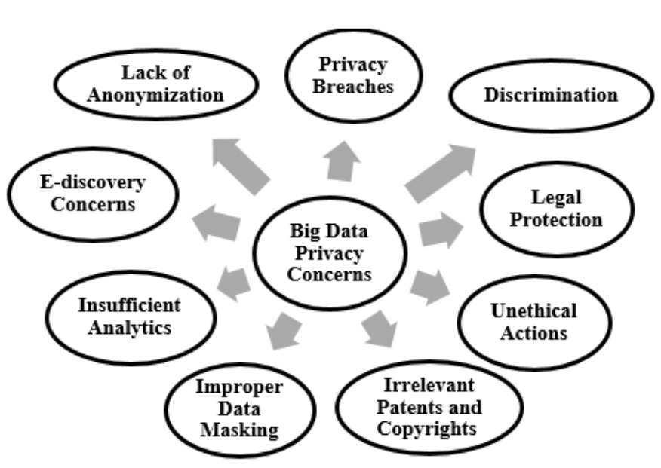
Context - Social
We are living in the world of Big Data.
Privacy-concern is getting more attention after Facebook scandal and GDPR effective (2018).
People don’t want to be analyzed deeply, also don’t want to be known publicly.
People are severely getting attention to search-privacy & location after Roe v. Wade overturned 26 Jun 2022 (US Supreme Court ends constitutional rights to abortion)
Source: Brohi, Sarfraz & Bamiah, Mervat & Brohi, M Nawaz. (2016). Identifying and Analyzing the Transient and Permanent Barriers for Big Data. Journal of Engineering Science and Technology. 11. 1793 - 1807.

Slide 6
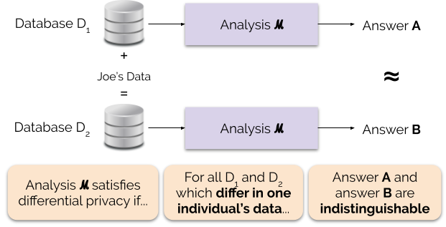
Context – Academic
Differential Privacy (DP) is emerging research area for dealing with privacy in Big Data & Data Analytics.
DP is a technology that provides researchers and database analysts a facility to obtain the useful information from the databases that contain personal information of people without revealing the personal identities of the individuals.
DP preserves the data distribution & statistics descriptive features.
Source: Differential Privacy for Privacy-Preserving Data Analysis: An Introduction to our Blog Series – NIST Blog - https://www.nist.gov/blogs/cybersecurity-insights/differential-privacy-privacy-preserving-data-analysis-introduction-our

Slide 7








Context – Corporate
Data partnership is forming between multi-parties (e.g.: Supermarkets with FMCGs, E-commerce platform with FMCGs,…)
Anonymization transactions data is sharing privately/publicly → leads to potential data reidentification while doing data analytics – especially for the problems of customer segmentation/customer life time value.

Slide 8
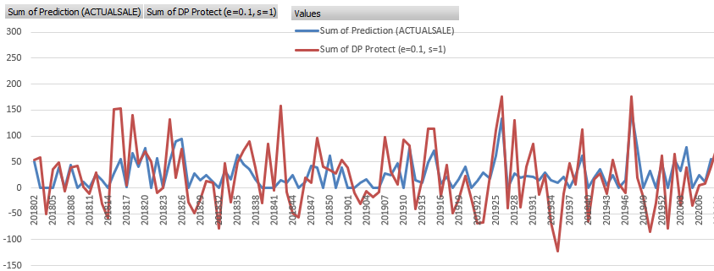
Urgency of this study
Traditional DP preserves the general data distribution – but not preserves the seasonality & other-TS features → Work badly on Time-series data.
Ultimate purpose:
Protect individual privacy
Preserves the analytical features: auto-correlation, seasonality,…
Low error data
Apply for multiple data-type: continuous, intermittent, long-history, short-term,…
➔ Need a deeper research on the DP method for time-series.
Figure: Personal experiment on corporate retail data – Test Laplace DP technique → Unusable TS

Slide 9
Literature Review

Slide 10
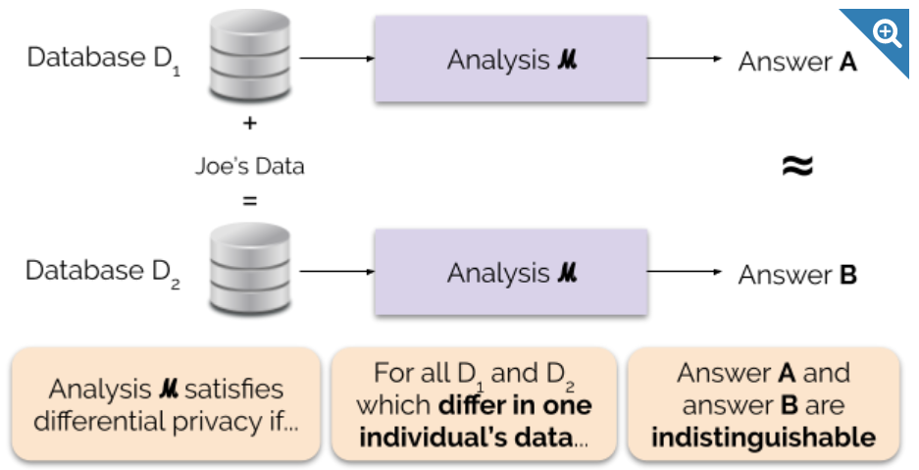
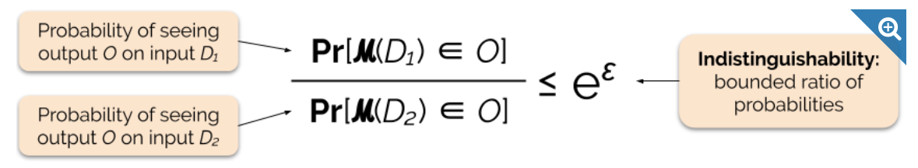
Differential Privacy
Differential privacy is a mathematical definition of what it means to have privacy → A extension in a process which can help to provide privacy (adopt from NIST)
The output of a differentially private analysis will be roughly the same, whether or not you contribute your data. A differentially private analysis is often called a mechanism, and we denote it ℳ. (adopt from NIST)
Figure: Informal DP definition - NIST
Figure: Formal DP definition - NIST

Slide 11
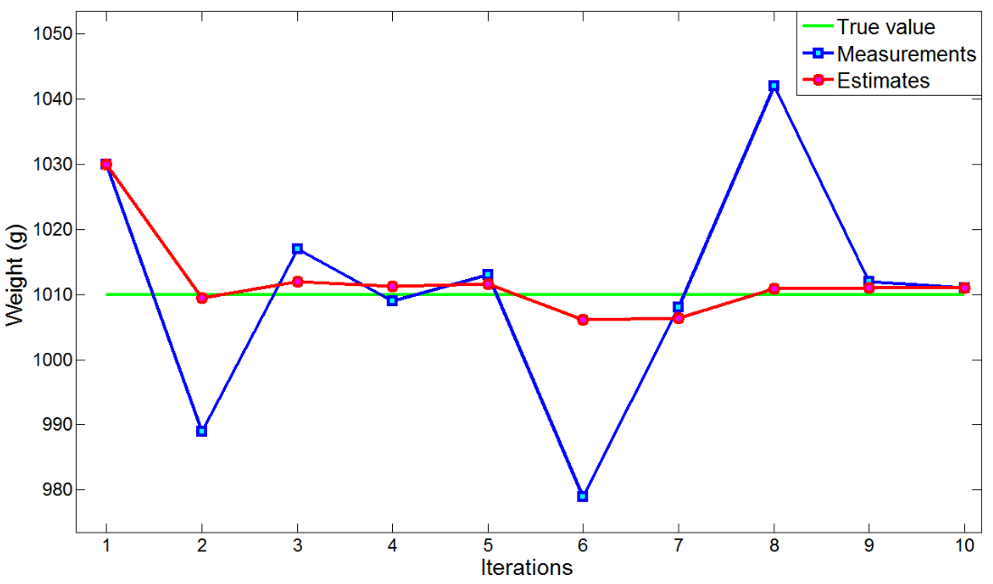
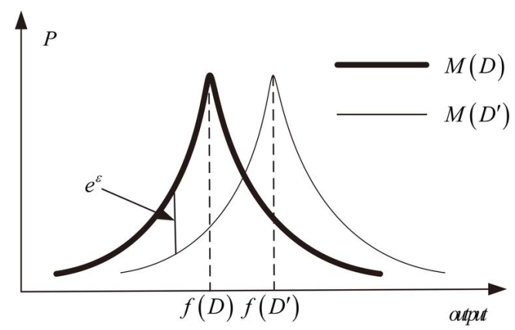
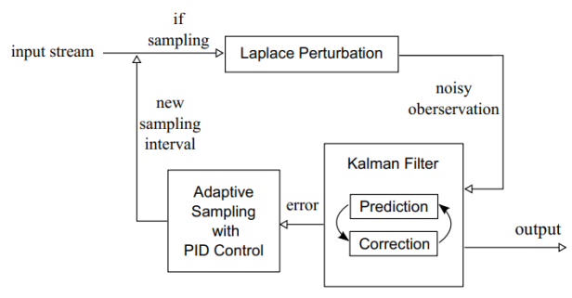


Some Differential Privacy techniques
Laplace technique
Kalman Filtering technique

Slide 12
About the thesis

Slide 13
Data information
Description: Daily customer transaction sales data – after anonymization (Retail TS data).
Data source: Corporate
Data structure:
CustomerID (anonymization ID)
StoreID (anonymization ID)
Region
Date
ProductID
ProductCategory
Quantities
Value
Potential attack for this kind of dataset:
Basket-size attack (attacker knows the usual basket size of target).
Basket-item attack (attacker has 1 receipt of target).
Location & Date & Product behavior.
Correlated attack (inference data-points)
Linkage attacks from public database (Facebook/Zalo/Twitter photos/status crawler → define behavior + check-in)
…

Slide 14
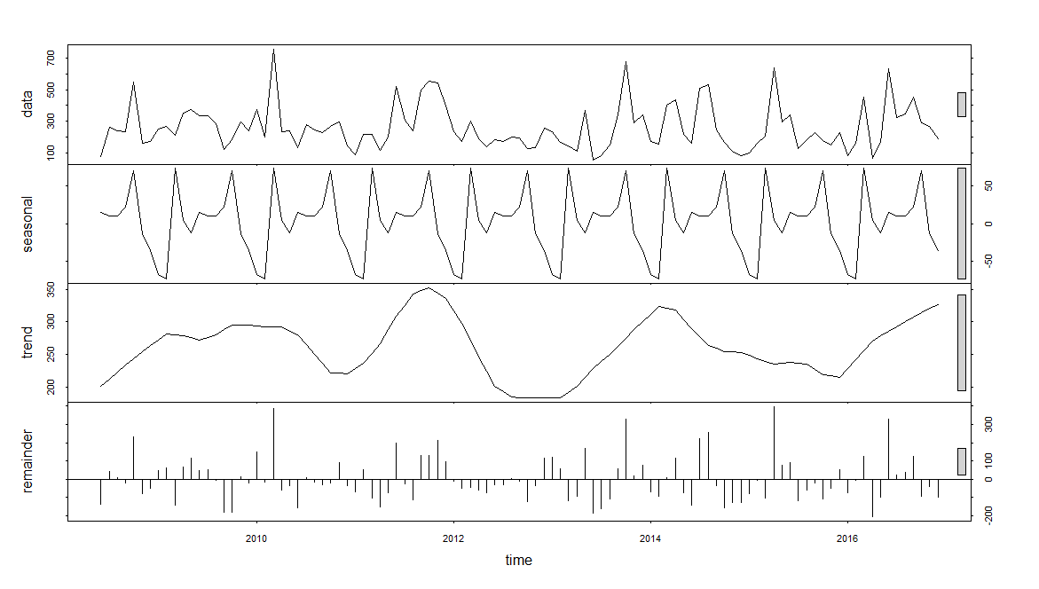
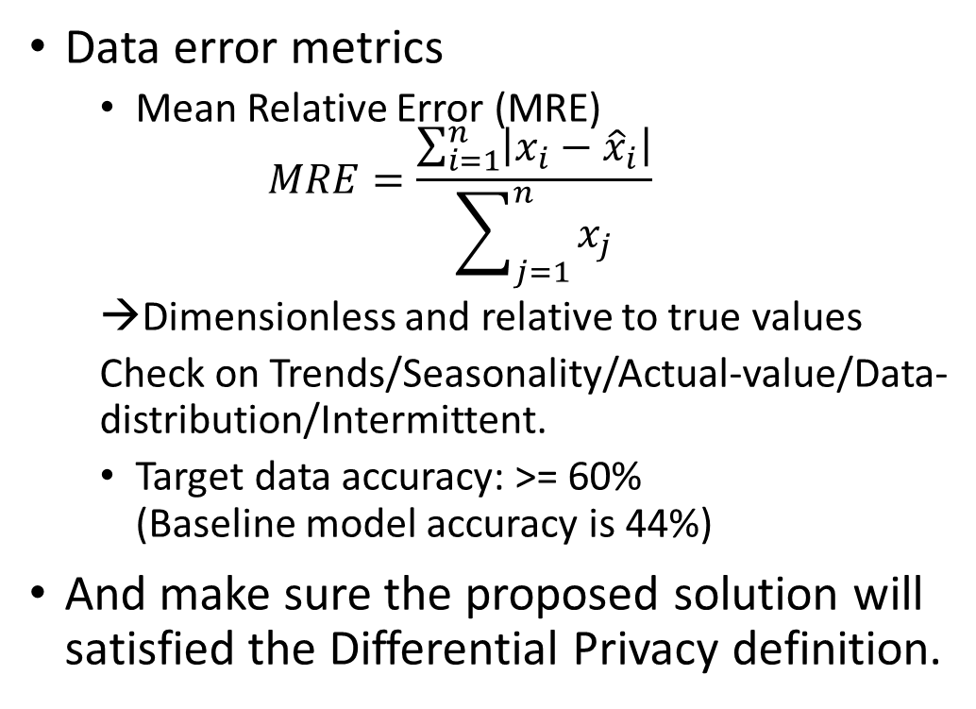
Data features analytics + Data error metrics settings
Data features analytics check
Trends and Seasonality check
Data distribution check
Intermittent check
Stationary check
Machine Learning model generator
Data error metrics
Mean Relative Error (MRE)
$$MRE=\frac{\sum_{i=1}^{n}{\left|x_{i}−{\hat{x}}_{i}\right|}}{\sum_{j=1}^{n}{x_{j}}}$$
Dimensionless and relative to true values
Check on Trends/Seasonality/Actual-value/Data-distribution/Intermittent.
Target data accuracy: >= 60% (Baseline model accuracy is 44%)
And make sure the proposed solution will satisfied the Differential Privacy definition.

Slide 15
Research outcome expectation
Compare proposed algorithms in literature review (Traditional Laplace/Gaussian, Kalman Filtering, DFT-IDFT)
Analyze data features and build algo-classification (which data-type go with which algorithms) by data features analytics check.
Propose a decision tree on choosing DP algorithms.
Package the solution and make it run (Python)

Slide 16
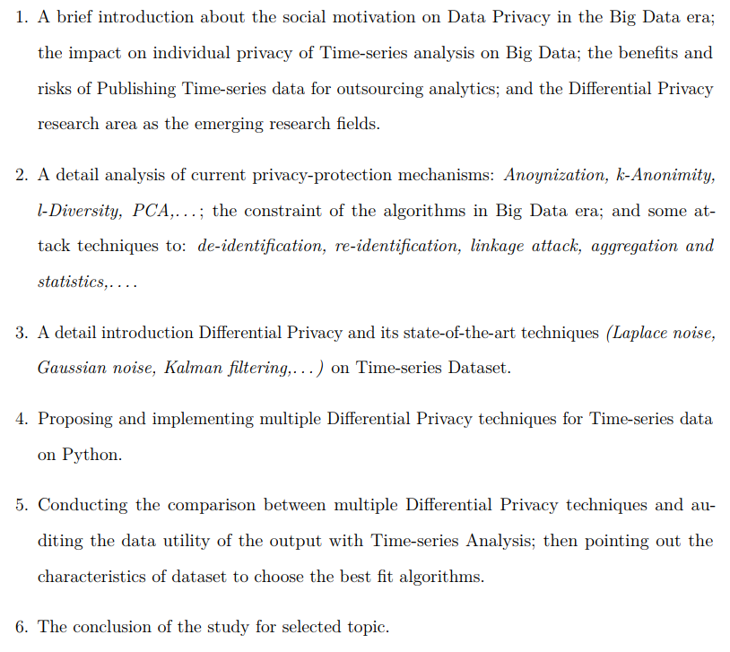
Thesis structure

Slide 17
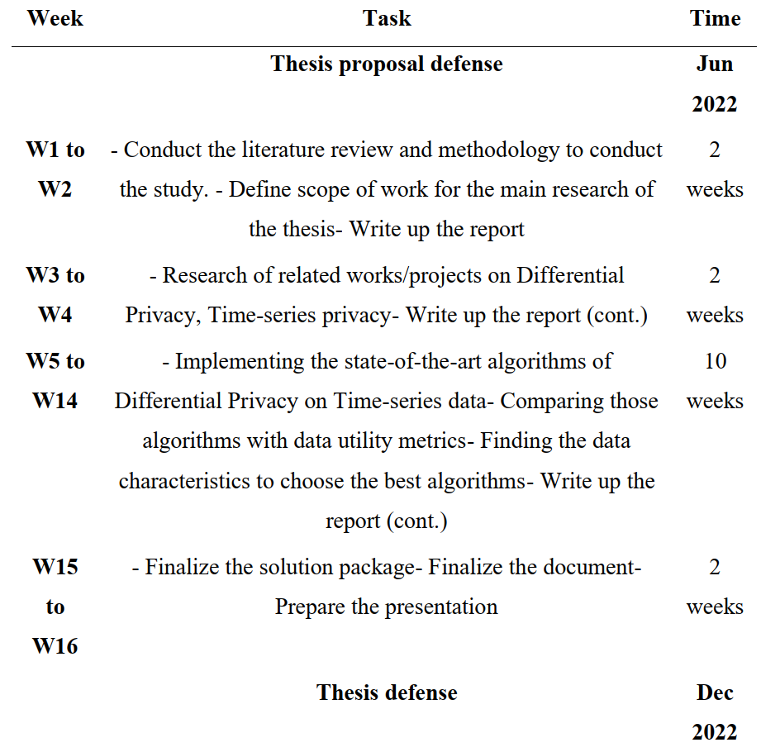
Expected timeline

Slide 18
Q/A
Thank you for your listening.

Slide 19
Reference (in this slide)
Xiong, W., Xu, Z., & Wang, H. (2017). An attack model on differential privacy preserving methods for correlated time series. International Journal of Database Theory and Application, 10. https://doi.org/10.14257/ijdta.2017.10.1.09
Ny, J. L., & Pappas, G. J. (2012). Differentially private kalman filtering. arXiv. https://doi.org/10.48550/ARXIV.1207.4592
Le Ny, J. (2020). Differentially private kalman filtering. In Differential privacy for dynamic data (pp. 55–75). Cham: Springer International Publishing. https://doi.org/10.1007/978-3-030-41039-1_5
Fan, L., Xiong, L., & Sunderam, V. (2013). Differentially Private Multidimensional Time Series Release for Traffic Monitoring. In L. Wang & B. Shafiq (Eds.), 27th Data and Applications Security and Privacy (DBSec) (pp. 33–48). Newark, NJ, United States: Springer. https://doi.org/10.1007/978-3-642-39256-6\_3
Cunningham, T., Cormode, G., Ferhatosmanoglu, H., & Srivastava, D. (2021). Real-world trajectory sharing with local differential privacy. Proceedings of the VLDB Endowment, 14(11), 2283–2295. https://doi.org/10.14778/3476249.3476280
Brickell, J., & Shmatikov, V. (2008). The cost of privacy: Destruction of datamining utility in anonymized data publishing. KDD
Arcolezi, H. H., Couchot, J.-F., Renaud, D., Bouna, B. A., & Xiao, X. (2022). Differentially private multivariate time series forecasting of aggregated human mobility with deep learning: Input or gradient perturbation? arXiv. https://doi.org/10.48550/ARXIV.2205.00436

